Slide 1
Moving Contact Line
Report, Apr. 2020

Slide 2
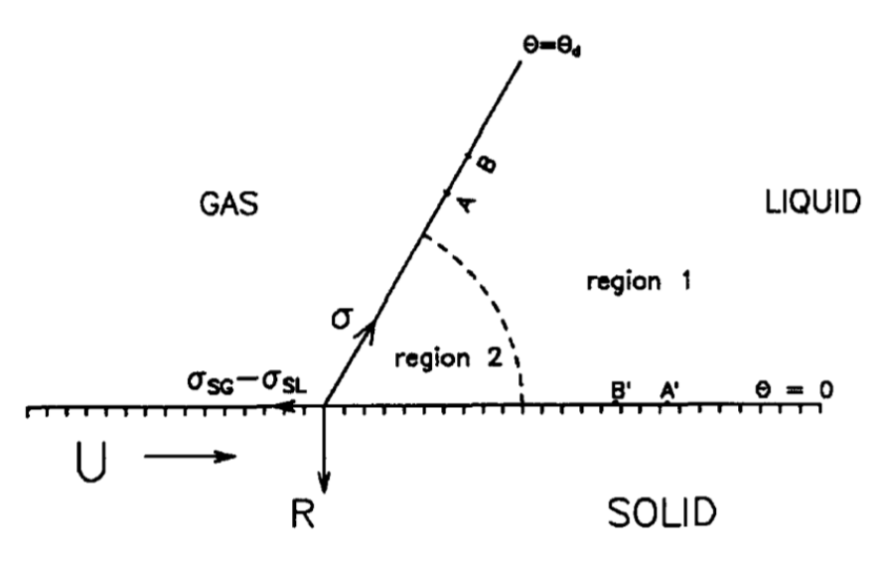
Recap: the singularity
No-slip

Slide 3
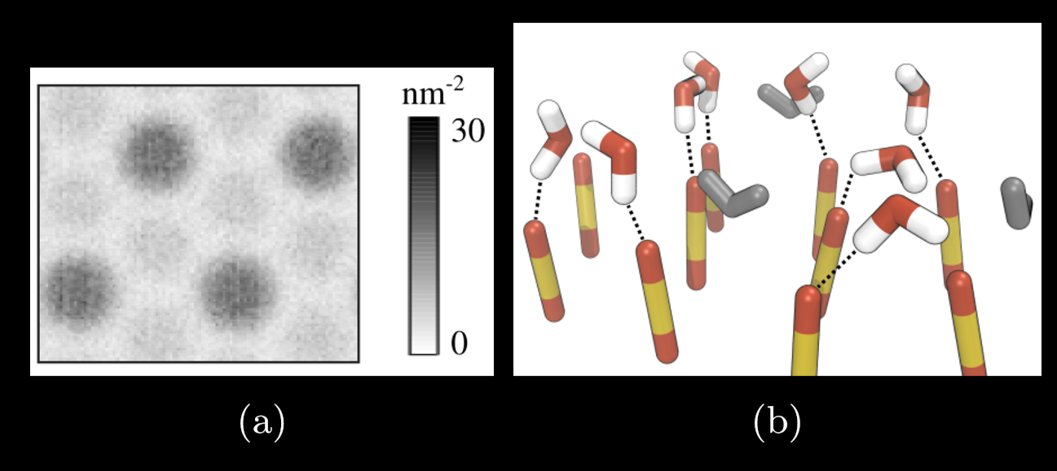
The nature of no-slip
Hydrophilic surface + water = no-slip
A 2015 study has shown that the no-slip condition in dynamic wetting is a consequence of liquid molecules forming hydrogen bonds with substrate molecules

Slide 4
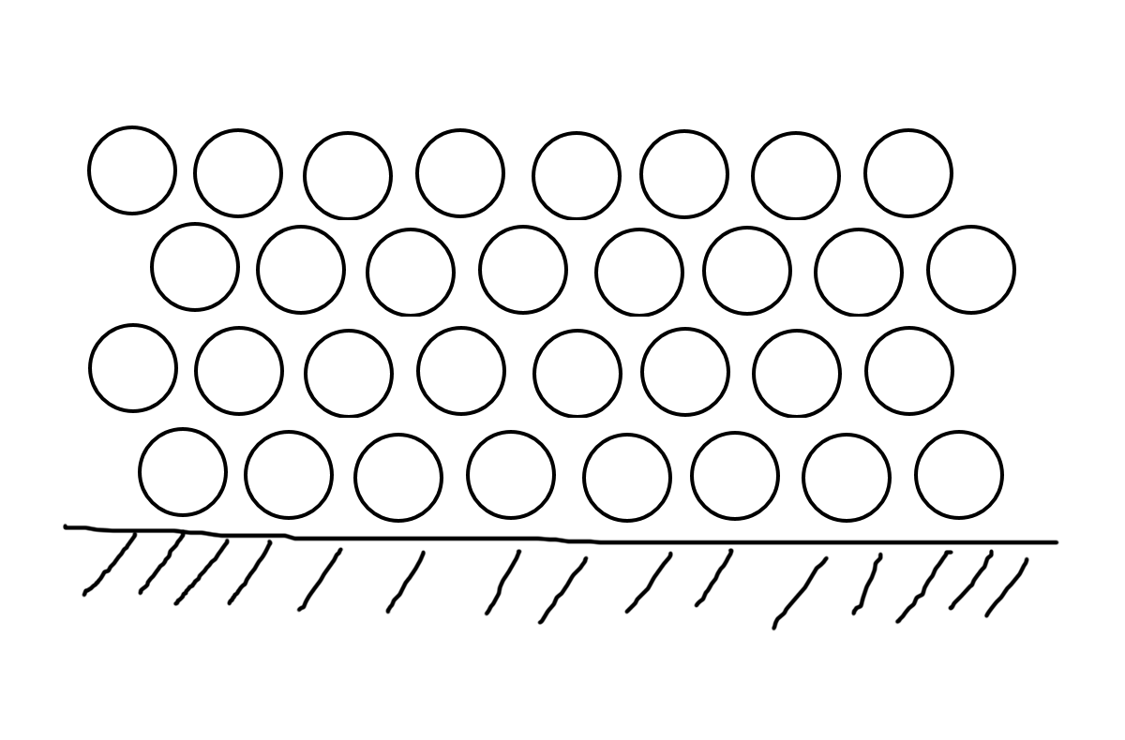
Strong vs weak friction
No-slip is a good assumption because…

Slide 5
Strong vs weak friction
However, when there is moving contact line…

Slide 6
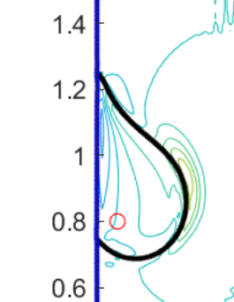
Hydrogen bonds CAN break. And it takes energy.
Local area that allows slip

Slide 7
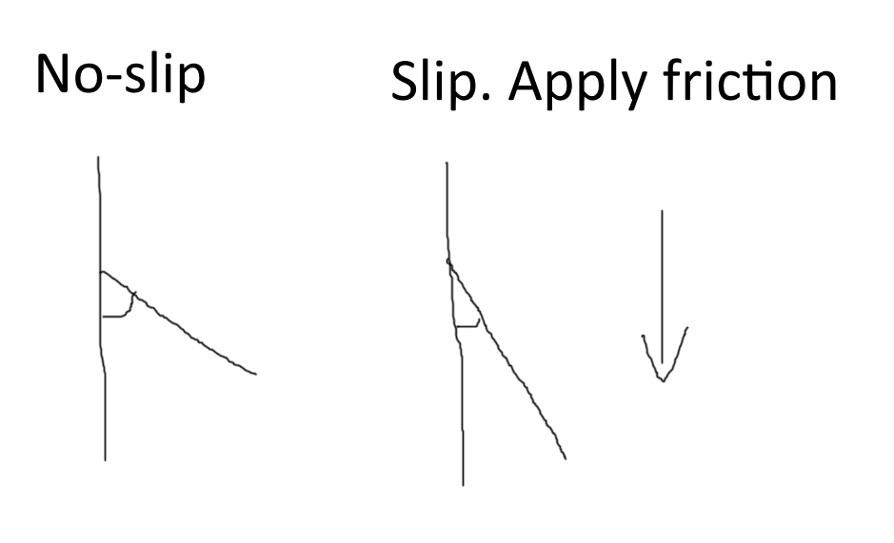
Guanhua suggestion

Slide 8
Hydrogen bonds CAN break. And it takes energy.
Now we just need a model for friction.
Local area that allows slip

Slide 9
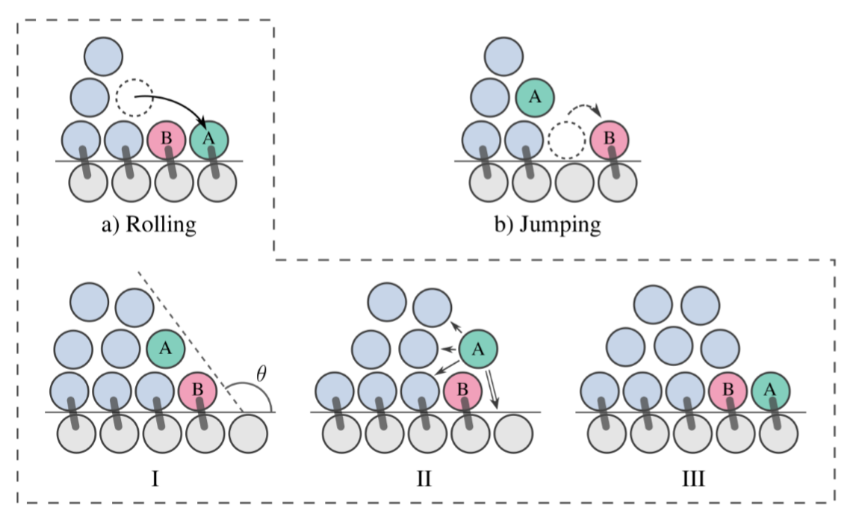
Petter Johansson and Berk Hess’s 2018 Study
Molecular simulation involving 1.2 million water molecules. Time step = 1ps

Slide 10
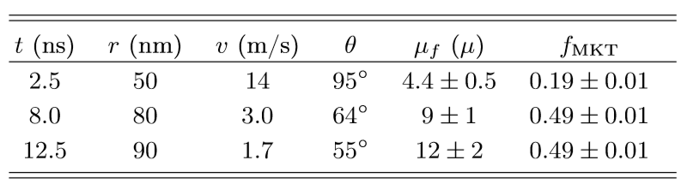
Their conclusion
Friction depends on contact angle

Slide 11
Three models
More Assumptions
More Assumptions
Microscopic | Macroscopic | Numerical
Johansson’s molecular model | Naiver-stokes with added friction | Penalty IBM with dynamic boundary properties

Slide 12
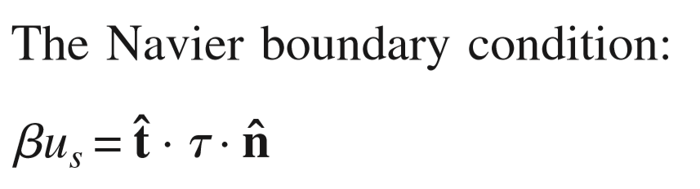
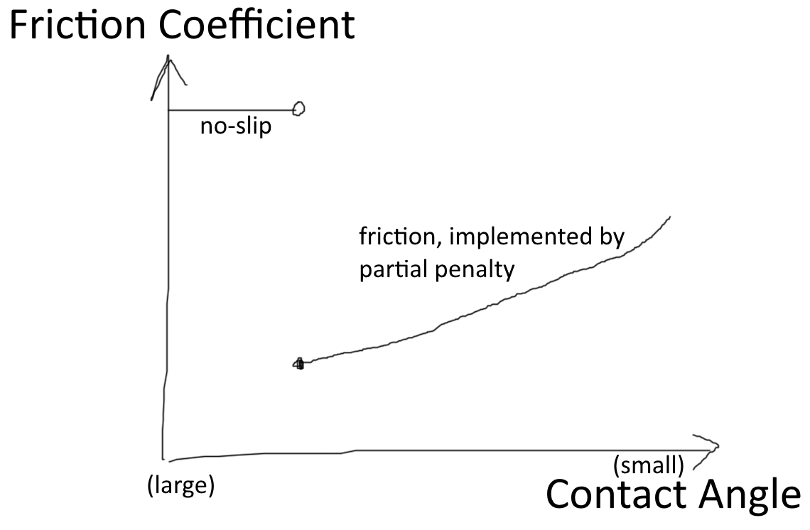
Naiver-stokes with added friction

Slide 13
Penalty IBM with dynamic boundary properties
Local area that allows slip

Slide 14
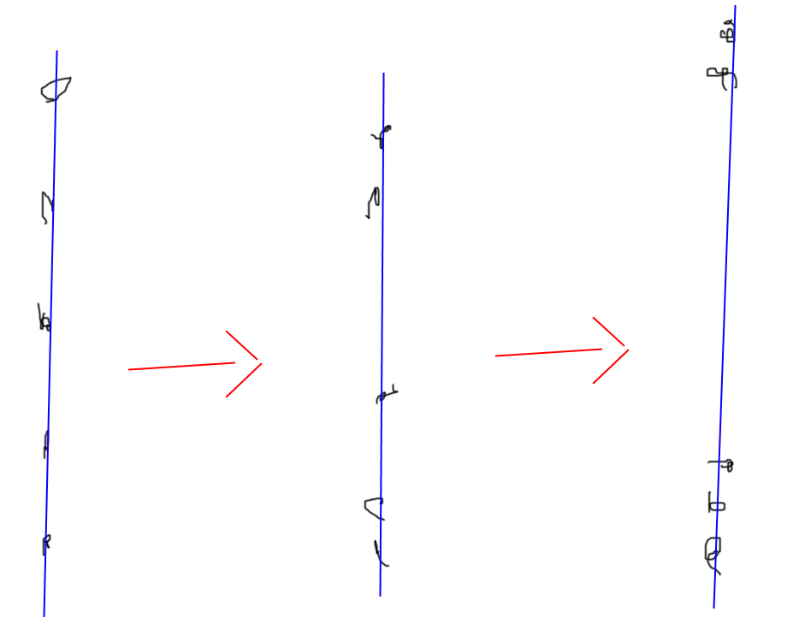
Problem with naïve penalty

Slide 15
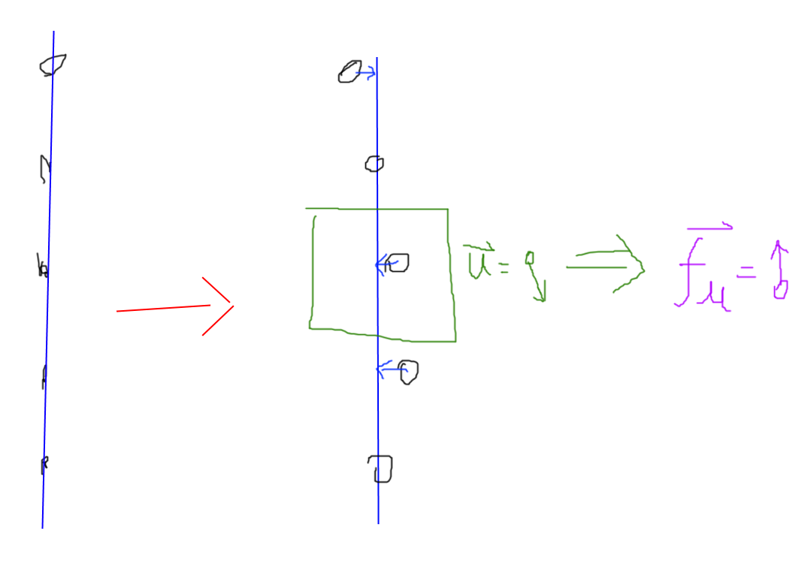
Solution

Slide 16
References
Petter Johansson and Berk Hess, “Molecular Origin of Contact Line Friction in Dynamic Wetting”
P.Johansson, A.Carlson, andB.Hess,“Water–substrate physico-chemistry in wetting dynamics,” J. Fluid Mech. 781, 695–711 (2015).
Y. D. SHIKHMURZAEV , THE MOVING CONTACT LINE ON A SMOOTH SOLID SURFACE.

Slide 17
Penalty can handle solid – fluid
The Guanhua paper simulates a piece of stone in fluid flow

Slide 18
Use penalty to simulate water – air?
Air
Water
Penalty relation?

